Slide 1

MKT1705X: CASE STUDY ON IKEA
Group 1
Angel Koh
Chi Hui
Elkan Hon
Gabriel
Gwen Su
Jolene Tan
Wang Tian

Slide 2
TABLE OF CONTENTS
01
02
03
INTRODUCTION
MACRO- ENVIRONMENTAL FACTORS
SUSTAINABILITY EFFORTS & IMPACTS
04
05
06
CONSUMER SEGMENTS & BEHAVIOURS
MARKETING STRATEGY & PROGRAM
RECOMMENDATIONS

Slide 3
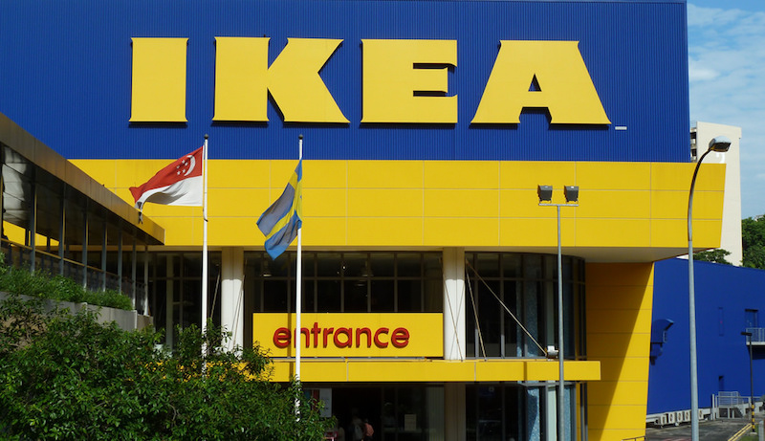
01
INTRODUCTION

Slide 4

About IKEA
Who? When?
USP
Founded in 1943 by 17 year old Swede Ingvar. Today, IKEA has hundreds of stores operating worldwide!
IKEA is known for their low-cost home furnishings and flat packed furnitures

Slide 5

02
MACRO- ENVIRONMENTAL FACTORS

Slide 6

Macro
Factors
(Demographic)
High Home Ownership among Singaporeans
Singapore has the HIGHEST home ownership in the world (>90%) since 2012
Increase in those staying in 1-3 room flats (Low to Mid Income)

Slide 7

Macro
Factors
(Economic)
High Disposable Income
Median Monthly Household income ↑ from $8666(2015) to $9425(2019) ⇒ Higher Purchasing Power
Effect of COVID19
↓ Household Income
Higher demand for home furnishings ⇒ Pent Up demand from Circuit Breaker & More staying at home
Permanent change in consumer behavior

Slide 8

Macro
Factors
(Technological)
High Internet Penetration
82.41% of Internet penetration ⇒ Allow IKEA to easily expand their online presence & tap into new markets
Advent of 3D printers
Likely to change the way furnitures are manufactured in the near future.

Slide 9
Macro
Factors
(Political)
Political Stability and Open Economy
Great support to attract foregin direct investment
Strong support to MNCs provided by various ministries (i.e EDB, MTI)
Strong & Supportive Policies (e.g. Smart Nation Initiative)

Slide 10

03
SUSTAINABILITY EFFORTS & IMPACTS
SUSTAINABILITY EFFORTS & IMPACTS
SUSTAINABILITY EFFORTS & IMPACTS

Slide 11

Sustainability Strategy

Slide 12



“People & Planet Positive” Strategy
Promote Healthy & Sustainable Living
Transform into a Circular & Climate Positive Business
Collaborate with Social Businesses

Slide 13
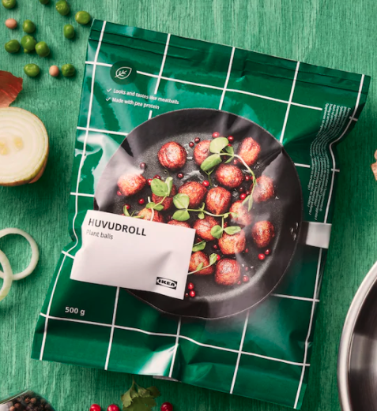
Promote Healthy & Sustainable Living
Develop & Serve more Plant-Based Options
Aims to make 50% of IKEA Restaurant Meals Plant-Based by 2025!
4%
Of the Climate Footprint compared to
Traditional Meatballs!

Slide 14
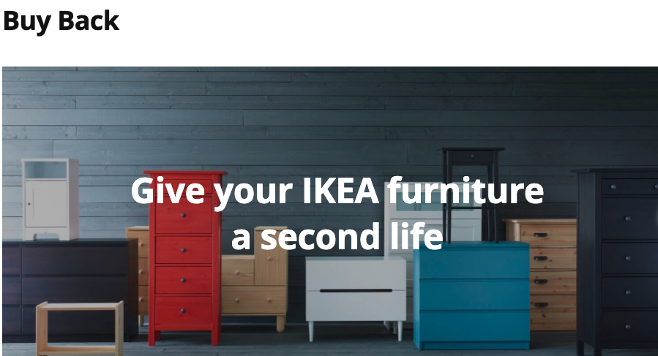
Transform into a Circular Business
Design all products with circular capabilities.
⇒ Recyclable
Enabled by circular services.
⇒ More convenient for customers to manage used products
Customers can trade unwanted IKEA furniture in exchange
for vouchers!
Conserves resources
Minimise contribution to landfills

Slide 15

Transform into a Circular Business
Investing in Climate Positive Activities
- Renewable Energy.
In 2019, Invested €200 Million to transform Supply Chain into 100% renewable energy by 2030.
Reported 16% reduction in Climate Footprint compared to 2016!

Slide 16
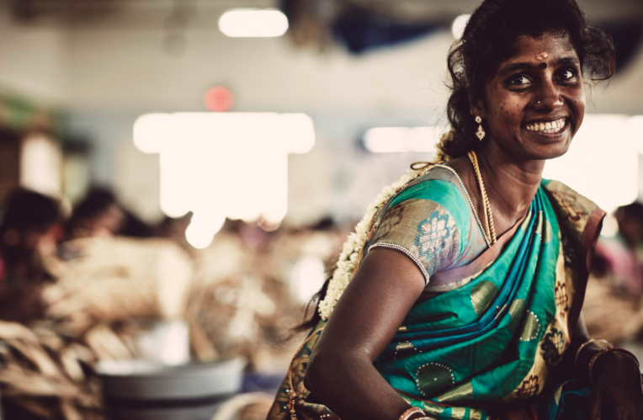
Collaborate with Social Businesses
Support Meaningful Work & Promote Equality
Create jobs for those living in vulnerable areas
By 2020, >30,000 jobs created!
Provided steady stream of income
Built a more inclusive, sustainable society
Notes:
https://gbl-sc9u2-prd-cdn.azureedge.net/-/media/ikeasocialentrepreneurship/ise-annual-review-fy20.pdf?rev=006dce6024d646c38d91d1c17c3f4cf1

Slide 17
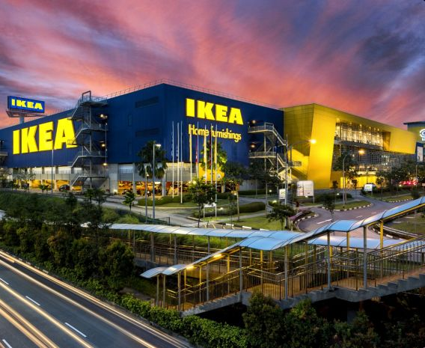
04
CONSUMER SEGMENTS
Notes:
The next segment we’ll be going through is the consumer segments that IKEA targets in the furniture market, as well as the buying behaviour of these customers

Slide 18



MARKET SEGMENTS
Demographic
Geographic
Notes:
The global furniture market is extremely large, with many different needs and demands across regions and demographics. As we all know already, IKEA is a very large multinational company with a footprint that spans across 52 countries and counting. As such, there is a need to segment their target markets such that they can specially target their marketing efforts and products towards specific segments. The 2 broad segments we have identified are demographic and geographic segmgents.

Slide 19

DEMOGRAPHIC SEGMENTATION
INCOME LEVELS
AGE & LIFE CYCLE STAGE
IKEA targets the lower to middle-income group with extremely affordable furniture
Carrying simple and minimalistic furniture, IKEA targets younger customers or couples moving into their first home
$$$
$$
$
Notes:
The first segment, demographic, consists of 2 factors. The first will be income level. A consumer’s income level usually determines their propensity to buy premium higher-end furniture or lower-end affordable furniture. On this end, IKEA sells extremely affordable and cost efficient furniture, catering to the lower to middle income segments, which usually forms the majority of the population.
The other demographic factor is age and life cycle. As IKEA’s furniture designs are simple and minimalistic, they target younger customers or new couples moving in to their first home. These simple and minimalistic designs are meant to appeal to the younger ones as well.
Simple and minimalist approach from the Ikea products → Good for young + cheap

Slide 20
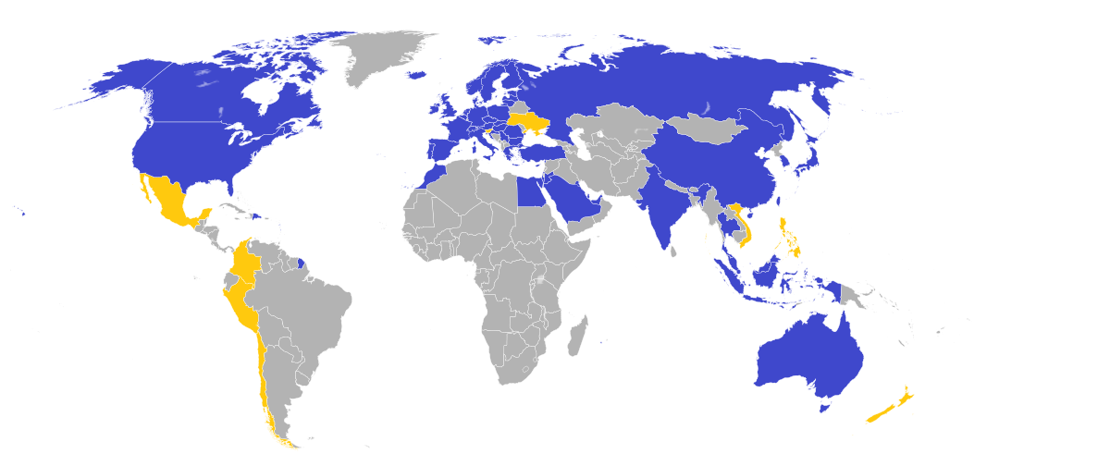
GEOGRAPHIC SEGMENTATION
Marketing Localization
Catering marketing efforts specific to a region
Population density to decide store location
Notes:
Moving on to geographic segmentation, with stores over 52 countries, IKEA MUST localize their marketing efforts as a one-size-fits-all method will not cut it across countries. Therefore, the IKEA marketing team has been known to conduct alot of ground market research within individual regions to specifically cater their marketing efforts.

Slide 21
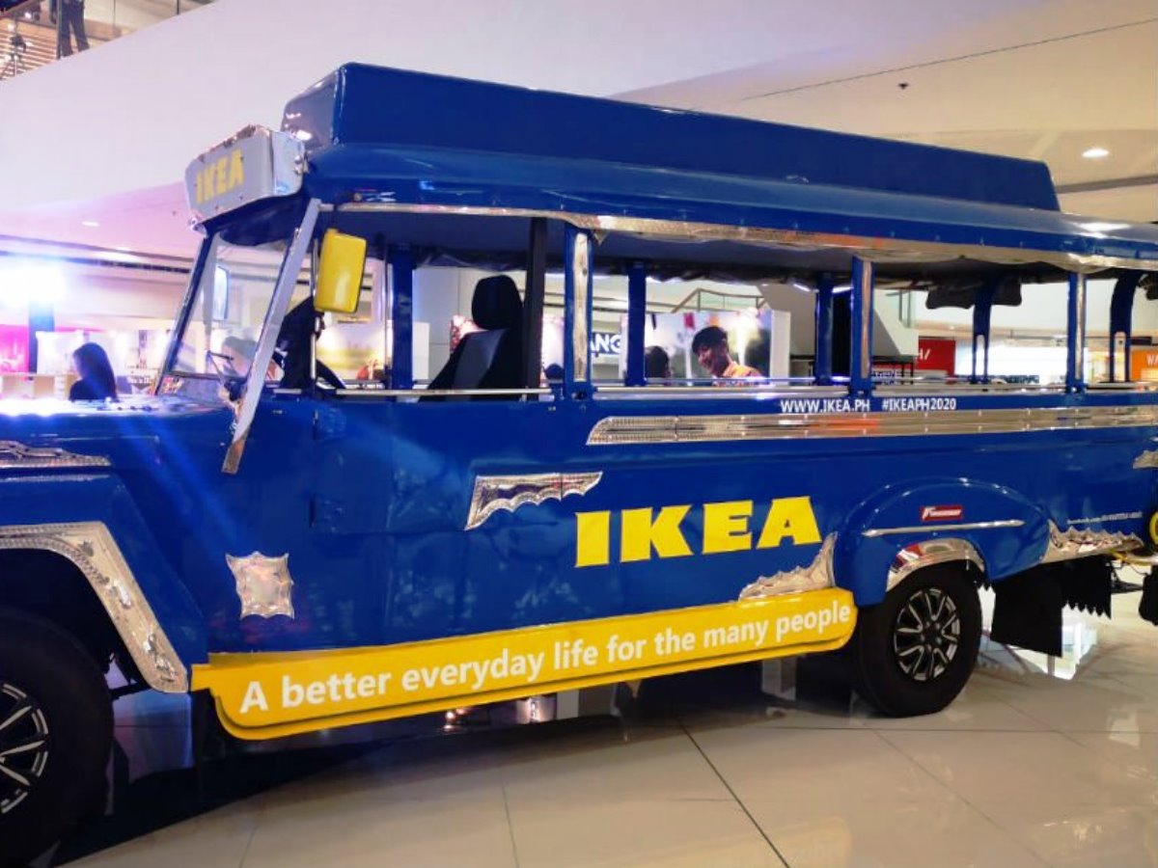
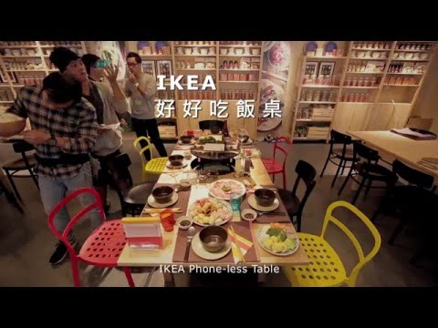
GEOGRAPHIC SEGMENTATION
IKEA Philippines
IKEA Taiwan
Notes:
These are some examples of IKEA’s geographic segmentation within Asia. In Manila, IKEA used the Jeepney vehicle, which is a cultural icon in Philippines, to promote the opening of its new mega store. Over at Taiwan, IKEA introduced a hotpot themed meal at their IKEA Cafe to cater to the Taiwanese trend of hotpot meals. Such measures appeal to the local crowd and has been effective in tailoring their efforts to specific regions.

Slide 22
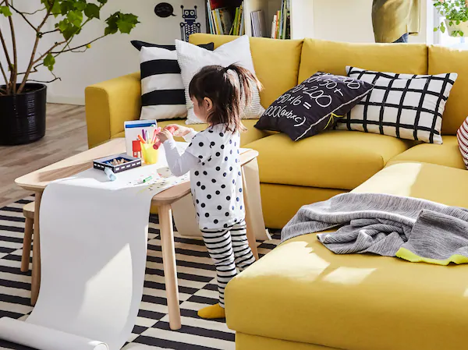
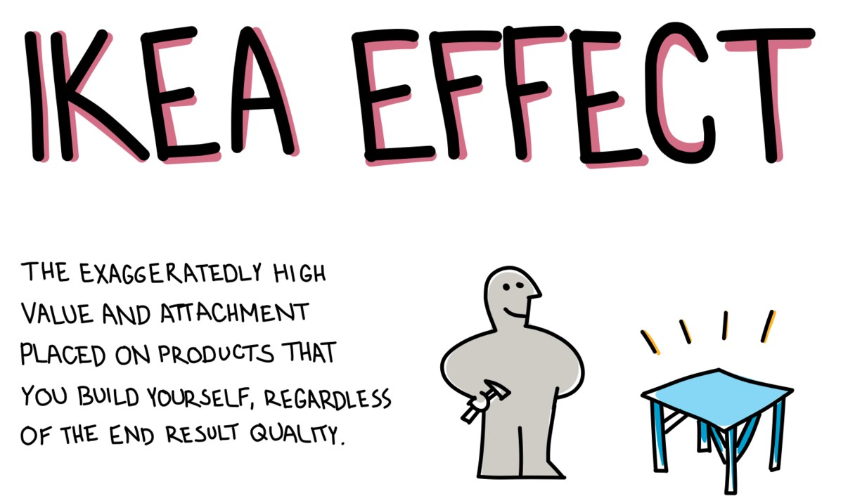
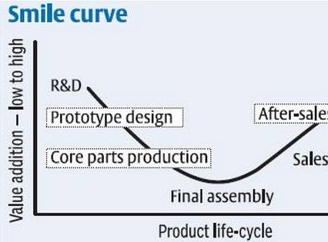
CONSUMER BEHAVIOURS
Personal
Psychological
42%
33%
84%
Consumers:
MOTIVATION
Lower income &
Limited purchasing power
+Leisure experience
PERCEPTION
Price-based decision making
Scenario marketing
IKEA:
Set price Design
Satisfaction
Labor leads to love
Repurchase behavior

Slide 23

05
MARKETING STRATEGY

Slide 24
Product
Furniture and lifestyle products
Renovation and interior design services
Restaurants

Slide 25
Price
Bulk manufacturing
Prices are decided before designing & manufacturing
Prices are lowered by 2-3% every year
Affordability

Slide 26
Place
IKEA Alexandra
IKEA Tampines
IKEA JEM

Slide 27
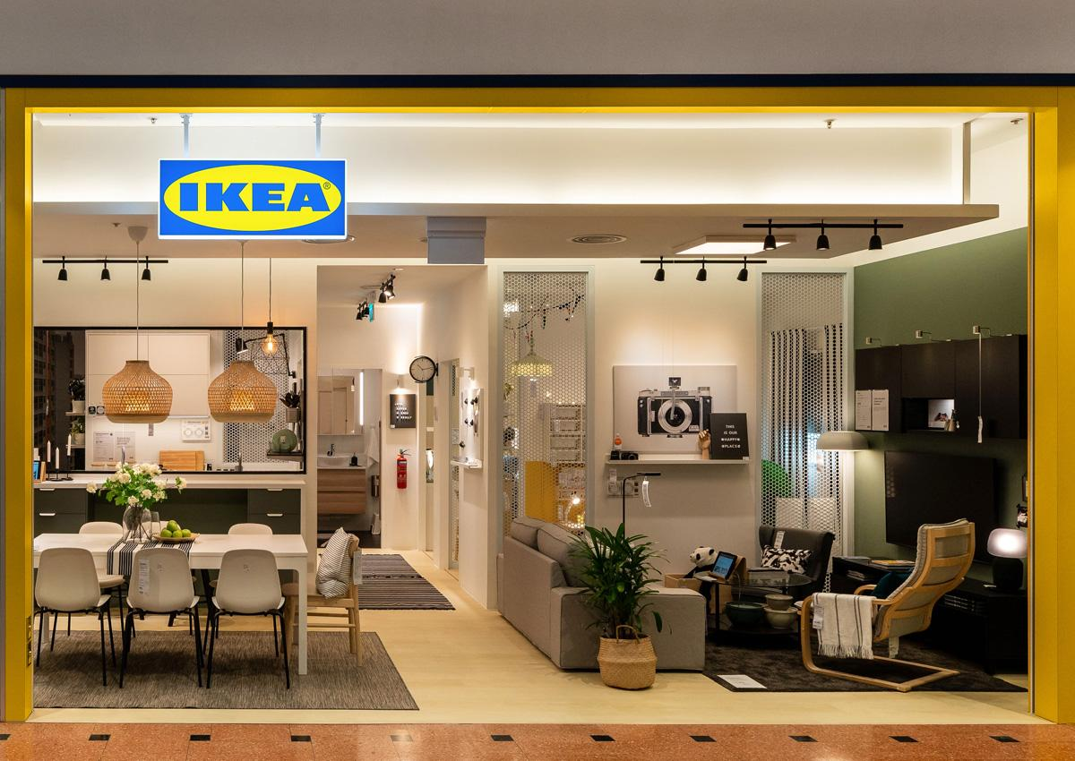
Place
Alternative places of retail
IKEA website
Active on various social media platforms (Facebook, Pinterest, Instagram, Twitter)
IKEA Jurong Point Planning studio

Slide 28
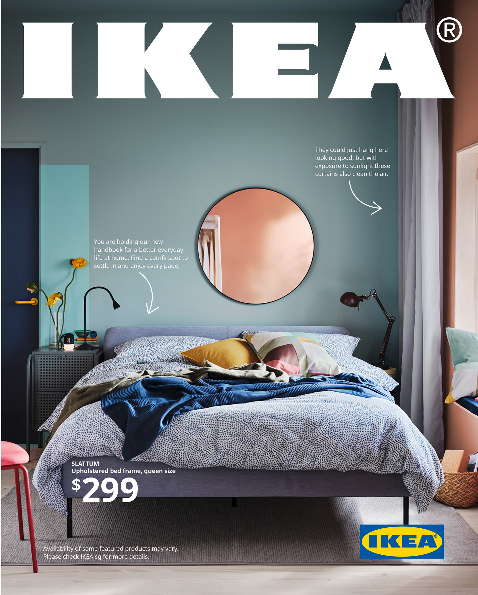

Promotion
Community outreach campaigns
E.g. Square Metre Challenge

Slide 29
Evaluation
Complementary and complimentary interior design and renovation services
Visualisation of furniture in homes
Further expansion into heartland areas
Strong content marketing

Slide 30

06
Sustainability Recommendations

Slide 31
Current Problems
Using recycled materials and particleboard to make their products
However, particleboard may be more environmentally detrimental
Encouraging bulk buying and throwing
Only actively promote their sustainability plans in regions where it is a concern among customers, and neglect to do so in other countries.

Slide 32
GLOBAL
COMPARISONS
INTERNATIONAL
SINGAPORE
Increasing consumer focus on sustainability and environment
Eco-friendly sustainable store in Greenwich
In-store events
Numerous marketing schemes
Sustainability is not a major concern for consumers
No promotions for sustainable items
No awareness of their sustainable efforts
No events held to change consumer behaviours

Slide 33
OUR RECOMMENDATIONS
PRODUCT PLACEMENTS
GO DIGITAL
HOST EVENTS
PUBLIC PERCEPTION
SALES PROMOTIONS
Replacing physical items with technology
Featuring sustainable items on various streaming platforms
To raise awareness for their sustainability efforts
Make their plans to be sustainable seem more genuine
Encourage customers to purchase more sustainable items

Slide 34
Thank You!

